Slide 1
Security by Any other Name: On the Effectiveness of Provider Based Email Security
By Ian Foster, Jon Larson, Max Masich, Alex C. Snoeren, Stefan Savage, and Kirill Levchenko
Presented by Yi Yuan

Slide 2
Outline
Introduction
Threat Model
Background
Measurement Methodology
Result
Related Word
Discussion
Conclusion

Slide 3
Introduction
how to make guarantees about Email integrity, authenticity, or confidentiality?
encrypt and sign message contents using tools like PGP
message tampering, forgery, eavesdropping
use of lower-layer security mechanisms: TLS, SPF, DKIM
Google recently reported 59% adoption of TLS by sending and 79% by receiving servers.
TLS, and DKIM with DNSSEC can protect against active network-based man-in-the-middle attack, when used correctly and enforced.
requiring trusting the provider

Slide 4
Research Question
Whether the current deployment of TLS,DKIM, and SPF provides these level of security possible under ideal conditions?
measuring the level of support for TLS, DKIM, and SPF among top email providers.
determining whether they enforce correct protocol use.
measuring the use of DNSSEC among providers.

Slide 5
Contributions
A methodology for determining TLS use along the full message path between two providers.
An analysis of current state of TLS, DKIM, SPF and DNSSEC deployment.
how correct use of the above protocols can provide message confidentiality and integrity in a relaxed treat model.

Slide 6
Threat Model
network-based attack
Active
an active attacker ( man-in-the-middle attacker), can observe and modify all packets, and inject arbitrary packets
Passive
A passive attacker can observe but not modify the traffic between a target and the rest of the Internet.
Peer
A network peer is an ordinary host connected to the Internet, capable of sending arbitrary packets and receiving packets for which it is the destination.

Slide 7
Background
Security Properties
Confidentiality: Can an attacker read a message?
Authenticity: Can an attacker forge a message?
Integrity:Can an attacker modify a message?
Mail Path

Slide 8
Background
Confidentiality
network-based eavesdropper
the standard protocols (HTTP,SMTP,IMAP,POP) use along the mail path defend against eavesdropping using TLS encryption.
passive attacker
it is sufficient to use TLS on all attacker accessible links, provided a strong cipher suite is sued.
active attacker
requiring the sender to verify the identity of the receiver.
attacker will be able to impersonate the receiver and gain access to the message
attacker can gain control of any hop along the message path
either TLS is not used on that hop
or TLS is used without server certificate verification

Slide 9
Background
Authenticity
SPF
protect against forgery by a peer attacker by only allowing certain network hosts to send email on behalf of a domain
DKIM
rely on a digital signature to protect the message, including the sender address
DNSSEC
If the sending provider uses DNSSEC, the receiving provider can obtain the DKIM signing key securely or receive signed confirmation that a record does not exist.
DKIM & DNSSEC can be used to defend against forgery of signed messages.

Slide 10
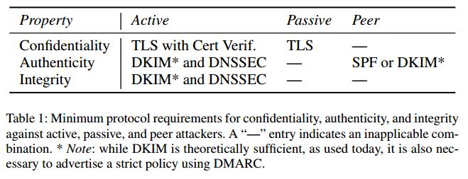
Background
Integrity
DKIM signatures can be used to protect message from tampering in transit
Enforcement
SPF & DKIM were developed primarily as a means to fight spam
DKIM signing policies can be enforced aggressively
GMail will not accept email from eBay or PayPal if it is not signed
Implications

Slide 11
Measurement Methodology
Subject Selection
path uniqueness
characteristics of TLS use along the path did not change during the measurement period
provider list
create the set of popular email providers based on the top 1 million email address domains occurring in the leaked Adobe user data set of September 2013
generator list
create a list of email generators by attempting to create an account with each service in the Alexa Top 100 list.

Slide 12
Measurement Methodology
Incoming MTA Behavior
Connect
EHLO
ESMTP
ESMTP Options
STARTTLS
TLS handshake
Mail transfer

Slide 13
Measurement Methodology
Outcoming MTA Behavior
HELO/EHLO
ESMTP Options
STARTTLS
TLS handshake
Mail transfer

Slide 14
Measurement Methodology
SMTP MAS Behavior
obtain mail submission configuration info from 22 providers
15/22 providers instruct the user to configure their mail reader to use TLS
POP and IMAP Behavior
all 22 provider offer POP and IMAP support
15/22 providers instruct the user to configure their mail reader to use TLS

Slide 15
Measurement Methodology
Webmail Behavior
all 22 providers support this option
Report TLS Use
map TLS use on the internal hops (b) and (d)
Cross-Provider Validation
sent message between all pairs of provider on the select provider list

Slide 16
Measurement Methodology
Certificates
check if the certificate was revoked or expired
DKIM
examine the messages used in the outgoing MTA measurement to determine if a DKIM signature is present
SPF, ADSP,DMARC, and DNSSEC
query the name server of providers on the provider list for DNS TXT record used by each protocol
make note of whether the provider’s mail server supported DNSSEC and returned signed records

Slide 17
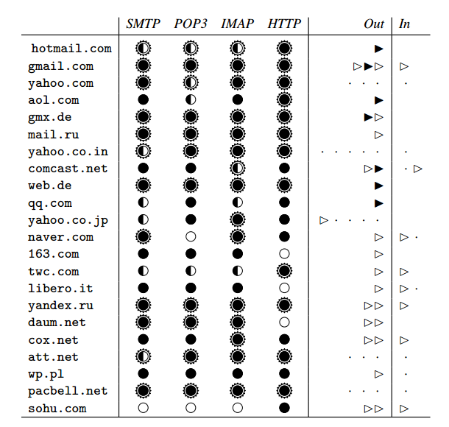
Results
Submission and Delivery
SMTP,POP, and IMAP
6/22 providers use a server
certificates that did not match the
server host name
web interface
all 22 provides offer web mail
interface, 3 of them do not offer
TLS support

Slide 18
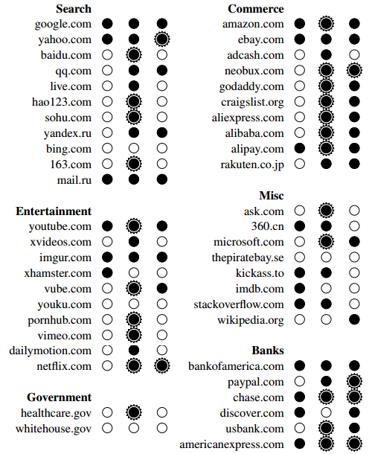
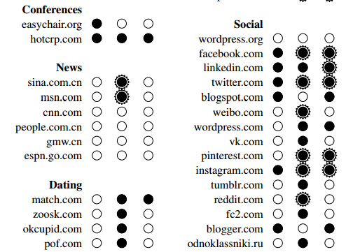
Results

Slide 19
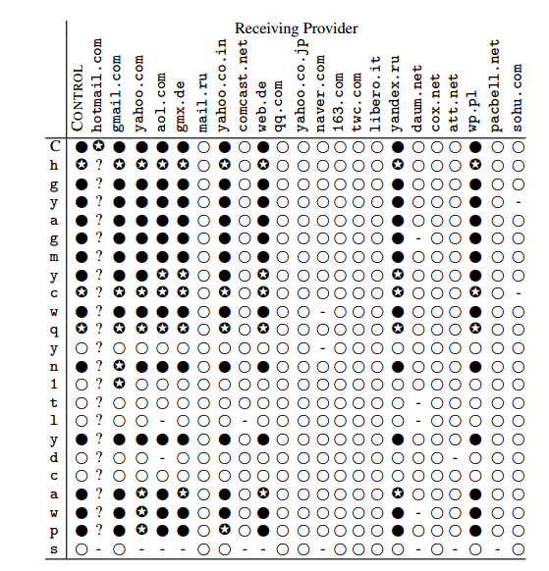
Results
TLS support at incoming MTAs
Pairwise TLS Support

Slide 20
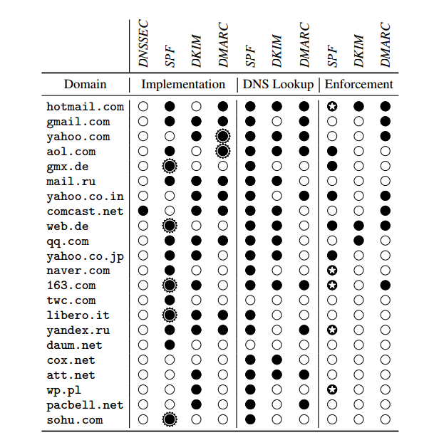
Results
SPF and DKIM
DNSSEC,DMARC,and ADSP

Slide 21
Related Work
Facebook Study
reported 76% of incoming MTAs for unique MX records offered STARTTLS when sending emails to their users, and about half of the certificates pass validation. 58% of Facebook’s outgoing notification email used TLS [1]
Google Study
Google reported 46% of outbound and 40% of inbound messages used TLS at the time of our second measurement (February 2015).
Durumeric et al. reported TLS use for 80% of incoming connections [2]
Durumeric et al. reported that 74% of incoming mail at GMail does not have a DMARC policy [2].

Slide 22
Discussion
Passive Eavesdropping attacks
best case
worst case
Peer Forgery Attack
Active Eavesdropping attacks
Active Tampering attacks

Slide 23
Discussion
Recommendations
Use TLS
Fix Certificates
Verify certificates
Require TLS
Certificate Pinning
Use DKIM and DMARC
Enforce SPF and DKIM policy
Use DNSSEC

Slide 25
Referenced List
M. Adkins. The Current State of SMTP STARTTLS Deployment. https://www.facebook.com/notes/1453015901605223, May 2014.
Z. Durumeric, D. Adrian, A. Mirian, J. Kasten, E. Bursztein, N. Lidzborski, K. Thomas, V. Eranti, M. Bailey, and J. A. Halderman. Neither Snow Nor Rain Nor MITM . . . An Empirical Analysis of Mail Delivery Security. In Proceedings of the 2015 Internet Measurement Conference (IMC), 2015.

Slide 26
Quiz
Name one type of network attackers.
what will happen when failure to verify the server's certificate of the MDA?
Any limitation for the approach?

Slide 27
Thanks

